Slide 1
Vendor risk management Lifecycle

Slide 2
Introduction
Establishing effective third-party risk management is not meant to be a deterrent from working with the vendors, suppliers, agents or other businesses that help make your company run. It’s actually the opposite. Effective risk management allows you to work with those third parties that provide the best results (and the least risk) to your organization’s success.

Slide 3
Levels of risk management for third party service providers
Pre-Contract
Contracting
Post-Contract Monitoring

Slide 4
Before you enter a formal relationship with the Vendor.
Pre-Contract
After you enter into the relationship with the vendors all of the way through termination.
Contracting
Post-Contract Monitoring
When you negotiate key terms and provisions with your vendors, and determine how you will share risk between the parties

Slide 5
When it comes to continuous monitoring, evaluation, and adaptation of the third party service providers, detailed and sequenced methodology is required. That’s where Vendor risk management lifecycle comes into picture

Slide 6
Vendor risk Management lifecycle
Vendor risk management (VRM) lifecycle refers to the process and activities involved in managing the risks associated with third-party vendors throughout their lifecycle within an organization.
VRM involves assessing, monitoring, and mitigating risks posed by vendors to protect the organization's data, systems, operations, and reputation.

Slide 7
Advantages of using VRM Lifecycle
Comprehensive Risk Assessment: The vendor risk management lifecycle enables organizations to conduct a thorough assessment of the risks associated with their vendors. By systematically evaluating factors such as security controls, compliance, data protection practices, and operational stability, organizations gain a holistic view of the risks they may face. This allows for informed decision-making and prioritization of risk mitigation efforts.
Proactive Risk Mitigation: By adopting a lifecycle approach, organizations can proactively identify and mitigate risks before they escalate into significant issues. The ongoing monitoring and assessment of vendors enable early detection of vulnerabilities or non-compliance, allowing organizations to take timely action and implement risk mitigation measures. This helps prevent potential disruptions, data breaches, or other negative impacts on the organization.
Regulatory Compliance: The vendor risk management lifecycle helps organizations meet regulatory requirements related to vendor management. By conducting due diligence, incorporating risk assessments, and ensuring vendor compliance with relevant regulations, organizations can demonstrate their commitment to regulatory compliance. This reduces the risk of penalties, fines, or other legal consequences resulting from non-compliance.
Improved Vendor Relationships: A well-implemented vendor risk management lifecycle promotes transparency, communication, and collaboration with vendors. Clear expectations, contractual obligations, and ongoing monitoring help build trust and strengthen the relationship between organizations and their vendors. This can lead to better cooperation, responsiveness, and a shared commitment to risk management, enhancing the overall effectiveness of the vendor relationship.
Enhanced Business Continuity: Effective vendor risk management ensures that organizations have contingency plans in place to address vendor-related disruptions. By identifying and addressing potential risks, organizations can mitigate the impact of any adverse events that may affect the vendor's ability to deliver goods or services. This helps maintain business continuity and minimizes the potential for operational interruptions or delays.
Cost Reduction: Implementing a vendor risk management lifecycle can lead to cost savings in the long run. By identifying and addressing risks early on, organizations can prevent costly incidents such as data breaches, non-compliance fines, or contractual disputes. Additionally, effective risk mitigation measures can lead to more efficient vendor relationships, reducing the risk of unexpected expenses and improving cost predictability.
Continuous Improvement: The vendor risk management lifecycle encourages organizations to continuously assess, review, and improve their risk management processes. By analyzing past experiences, lessons learned, and feedback from vendor relationships, organizations can refine their risk management strategies and incorporate best practices. This enables continuous improvement in identifying, assessing, and mitigating vendor-related risks.

Slide 8
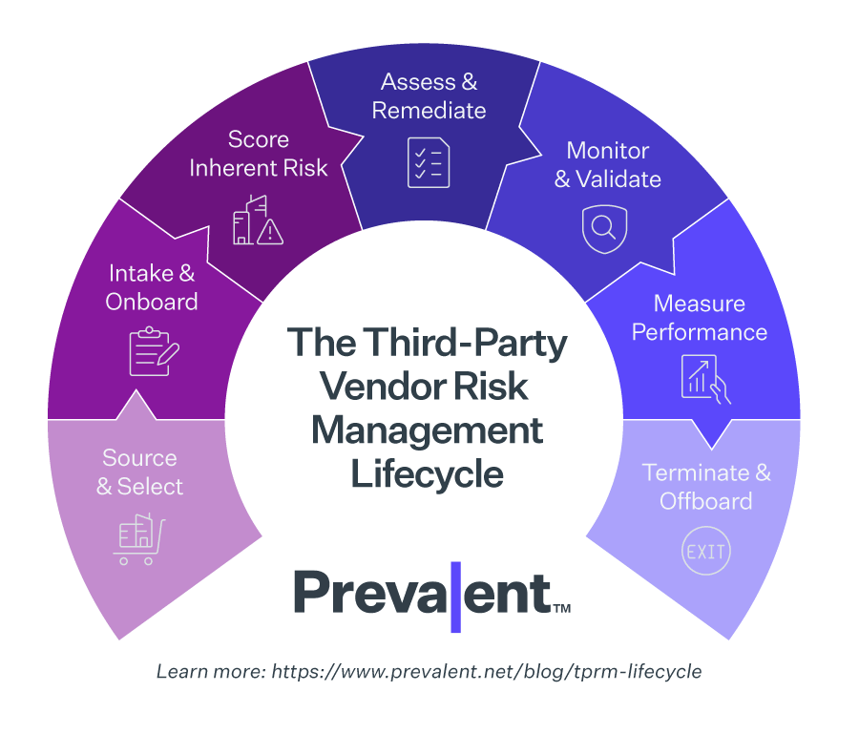
Vendor risk management lifecycle

Slide 9
Vendor Source and Select
Vendor risk management starts with vendor selection. In many cases, multiple teams are involved in the vendor selection process – each with different priorities. For instance, engineering may focus on prospective vendor’s ability to meet specifications; procurement on their business viability; security on their controls for protecting sensitive systems and data; and compliance on reporting and audits.
In addition, vendors often provide inconsistent and/or contradictory answers on vendor risk assessment questionnaires. This can make it extremely difficult to accurately gauge the risk they pose to your organization. These issues can become particularly acute when organizations lack a single source of truth for vendor information.

Slide 10

Vendor Sourcing and Selection Best Practices
Use a Vendor Risk Management Database: Many organizations are still stuck using spreadsheets to correlate vendor risk assessment questionnaire answers with security controls, compliance, and other requirements. Consider using a vendor risk management database or a third-party risk management platform to speed selection, improve vendor risk identification, and maintain a single source of truth for vendor data.
Base Standardized Questionnaires on Profiled Risk: Each vendor has a different degree of profiled risk (i.e., risk related to the service they perform for your organization). A vendor dealing with personal identifiable information (PII) or protected health information (PHI) will have a dramatically higher risk profile than a plumbing company. Create standardized questionnaires for different vender tiers based on profiled risk. For companies with low profiled risk, a simple questionnaire may suffice, while companies that interact with your IT environment or sensitive data may need a more comprehensive questionnaire.
Incorporate ESG Into Your Vendor Selection Process: Environmental, social and governance (ESG) risk is becoming increasingly important for companies around the world. Both investors and consumers are beginning to expect that companies carefully consider the environmental, ethical and social costs associated with their third parties. Incorporating ESG risk from the beginning of the vendor risk management lifecycle alongside evaluations of security and data privacy controls can help you avoid companies with questionable track records regarding environmental destruction, modern slavery, and other ethically problematic business practices.

Slide 11
Intake and Onboarding
The process for onboarding vendors typically involves a manual or bulk upload of profile information. Connecting a pre-configured spreadsheet or API to an existing vendor management or procurement solution is a more efficient way to create a central repository of vendors. Leverage role-based access to enable different teams to populate vendor data and invite other employees to contribute.

Slide 12
Vendor Intake and Onboarding Best Practices
Create a Formal Approval Process: There should be a documented, formal approval process for onboarding new vendors. Consider including standard templates for payment terms, invoicing, and information security standards as part of the supplier onboarding process.
Set and Communicate Realistic Onboarding Timeframes: Onboarding can be a long process. You need to provide vendors with credentials to access facilities or systems; ensure that they are able to perform their roles; and iron out payment terms and other processes. Make sure to set and realistic onboarding timeframes and clearly communicate them to both your vendors and internal departments.
Keep Compliance in Focus: Many organizations count on their initial third-party compliance assessment to ensure they are compliant throughout the vendor lifecycle. However, be sure to keep compliance requirements in mind as the contract matures. Scope creep is common, and vendors can sometimes be granted access to sensitive data and systems that weren’t accounted for in the early stages of the sourcing and selection process. Make sure that you fully understand where your data lives, and what your vendors have access to as part of the onboarding phase, and be sure to regularly review the vendor's access and adjust required security controls accordingly.
Automate Where Possible: Onboarding new vendors can be time consuming. Time constraints can become particularly acute when simultaneously onboarding multiple vendors. That’s why automation is key to a scalable third-party risk management program. For instance, you can automate questionnaire distribution and enable intake forms to be easily shared between team members.

Slide 13
Scoring Inherent Risk
Inherent risk scoring is a key part of the third-party risk management lifecycle. Not every vendor requires the same scrutiny. For example, an office supply vendor presents lower organizational risk than one providing critical parts or legal services. An organization located in a politically volatile location, with a history of breaches, or with poor credit history presents more risk and warrants increased due diligence.
To properly understand the risk posed by a vendor, you must be able to calculate inherent risk. This is the vendor’s risk level before accounting for any specific controls required by your organization. A comprehensive view of inherent risks provides a baseline and helps you decide what type of further due diligence is required. Once inherent risk is baselined, it is much more straightforward to calculate residual risk, or the risk level remaining after controls are applied.
Inherent risk can also inform vendor profiling, tiering, and categorization decisions. This accelerates risk assessments by ensuring vendors are assessed against the risks and standards that matter most to a business, its customers, and regulators or standards bodies.

Slide 14
Inherent Risk Scoring Best Practices
Map Your Vendor Risk Assessment to Compliance Requirements: Questionnaires should reflect any compliance requirements that your organization falls under. If your vendor has access to sensitive information such as PII, PHI or financial information, you need to ensure that you map your organization's compliance requirements to your vendor risk questionnaires. Below are some questions that should come up during the risk assessment:
Is the organization certified to any third-party information security standards or frameworks? (e.g., SOC2, NIST 800-53, NIST CSF, CMMC)
Does the organization fall under cybersecurity or information security compliance requirements? If so, which ones?
What policies and processes are in place for sharing customer data with third and fourth parties?
Don’t Go It Alone: Using a TPRM platform can dramatically speed up vendor risk assessments and allow you to quickly map questionnaire responses to compliance requirements. In addition, dedicated third-party risk management solutions like Prevalent offer built-in, customizable inherent risk questionnaires that can make it easy to seamlessly identify vendor risk.

Slide 15
Assessing Vendors & Remediating Risks
The level of risk posed by different third parties will vary according to their criticality to your business and other factors. Likewise, the criteria for each tier of third parties will also vary. For instance, the criteria for a parts vendor will be different from those used for evaluating cloud hosting services.
Organizations with immature TPRM programs may address different vendor tiers by creating individual, spreadsheet-based surveys for each new project; constantly “reinventing the wheel.” Responses to these surveys can differ in the level of detail and completeness, making it difficult to evaluate overall risk and required controls. Tracking open items that require remediation and ensuring that remediation controls are consistent and adequate can be difficult, putting unnecessary demands on scarce security, risk, and compliance resources.

Slide 16
Vendor Assessment & Remediation Best Practices
Leverage a Shared Library: Third-party risk management processes can be taxing for under-resourced teams. Data collection processes and vendor back-and-forth communications account for the largest share of time needed to reduce risk and complete assessment assurance. Compounding this issue is the ever-shifting regulatory landscape, which requires expertise to interpret compliance reporting obligations. Achieving compliance and meeting vendor risk management requirements while maximizing your team’s skill sets is a balancing act, for sure.
Ensure Questionnaire Flexibility: Vendor risk questionnaires aren’t “one size fits all.” Utilizing a third-party risk management platform that has multiple options for questionnaires, as well as the ability to generate custom questionnaires, can make vendor assessments far simpler. Using a dedicated platform can reduce the manual labor behind vendor survey and response management by 50% and ensure that assessment questionnaires are appropriately matched to each vendor’s profiled risk.
Save Time with Built-In Remediation Guidance: Sometimes vendor assessments reveal concerning facts. It may be that the vendor in question has experienced a data breach, isn’t compliant with data privacy regulations, or lacks a formal cybersecurity program. Platforms that deliver built-in remediation guidance can provide straightforward templates for remediation requests, plus workflow and task management capabilities to facilitate and streamline the entire process.
Compliance Reporting Matters: In many cases you need to consider information security and data privacy compliance when working with vendors. When you are identifying your third-party risk management strategy, consider how different platforms handle compliance reporting. Utilizing a TPRM platform that includes automated compliance reporting for an array of national and international compliance requirements can dramatically simplify audits and reduce the risk of non-compliance.

Slide 17
Continuous Monitoring
Although periodic assessments are essential to understanding how vendors govern their information security and data privacy programs, a typical risk assessment can only provide a snapshot of your organization’s risk profile at a single point in time. This profile can change overnight as threats evolve, new breaches and business challenges are disclosed, or other adverse conditions arise. Constant monitoring of a third party’s cybersecurity practices is important. So too is gaining visibility into other types of business changes such as financial, reputational, compliance, and supply chain issues that can create business risk.
Unfortunately, this data is rarely available in a way that enables security and risk teams to be quickly notified, and it is often not integrated into a central register for decision making. Instead, many organizations rely on manual processes, disparate tools, vendor notifications, and news reports.

Slide 18
Third-Party Monitoring Best Practices
Don’t Forget Fourth and Nth Parties: It can be tempting to diligently monitor your third parties while forgetting about their third parties and Nth parties. If your vendor relies on other companies to fulfill contracts and run their business, then your organization may ultimately be impacted by any security exposures or operational issues affecting these other parties. During the risk assessment process, you should therefore identify any fourth parties that are critical to your third party’s success. Consider a scaled-back cyber and financial monitoring process for fourth parties based on their risk to your third party.
Consider Multiple Types of Cyber Risk: Identifying vulnerabilities in a vendor’s public-facing IT systems is only part of the continuous monitoring equation. It’s important to go beyond vulnerability scanning to reveal other indicators of cyber risk, including:
Dark web chatter – Recent, frequent mentions of a company on the Dark Web often correlate with more threat activity against the company, increasing the likelihood of attack. Attention on dark web markets may indicate the illicit sale of company assets or accounts, or fraud schemes.
Domain abuse/typosquatting – New domain registrations with typosquatting-style similarity to existing corporate domains are potential indications of domain abuse (such as phishing), defensive registration to prevent or mitigate domain abuse, or both.
Email security – Sender policy framework (SPF) policy configurations; domain keys identified mail (DKIM); and domain-based message authentication, reporting and conformance (DMARC).

Slide 19
Third-Party Monitoring Best Practices contd…
Leaked credentials – Exposed credentials and emails indicate potential password or corporate email address reuse by company employees, raising the risk of credential stuffing attacks and targeting by threat actors.
Incidents – Security breach disclosures and validated cyber-attack reports signal when a company has likely experienced a recent cyber-attack, breach, or event that jeopardized the company’s information assets.
Infrastructure exposures – These include IT policy violations, abuse of company infrastructure, infections in company infrastructure, malware, misconfigurations, vulnerabilities, infected hosts, and unsupported software.
Web application security – SSL/TLS certificates and configurations.
Don’t Stop at Cyber Risk: Many companies focus on cyber risk because it is usually easily quantifiable and straightforward to address. However, cyber risk monitoring should be complemented by business, financial, and reputational monitoring. When building out your third-party monitoring program, be sure to account for these other types of risk. Some questions to consider:
Is this vendor financially healthy? Do they have a significant possibility of going bankrupt or experiencing other financial disruptions in the foreseeable future?
Does this vendor engage in ethical business practices?
Does this vendor abide by applicable laws and regulations?

Slide 20
Managing Ongoing Performance and SLA’s
Managing risk is a continuous process. Even reliable partners can experience disruptions, and incentives to implement promised controls can wane once an agreement is signed. This changing risk environment requires not only continuous external risk monitoring, but also ongoing visibility into vendor performance obligations.
Some vendors may require scrutiny to ensure remediation commitments are met, and all should be measured against their service level agreements (SLAs). Trying to manage this with spreadsheets or other manual methods can increase the likelihood of missed SLAs and associated business disruptions.

Slide 21
Vendor Management Best Practices
Regularly Assess Vendor Performance: It can be tempting to take a one-and-done approach to assessing vendors. However, this can lead to bad work outcomes and failed business relationships. Performing periodic assessments to ensure that vendors meet their SLAs and other contractual obligations can help catch any issues early.
Define the Right KPIs and KRIs: Defining the right key performance indicators and key risk indicators is critical to effectively evaluating vendor performance. KPIs can help you ensure that contractual obligations are fulfilled and business objectives are met throughout the contract lifecycle. KRIs can inform your understanding risks posed by vendors from onboarding to offboarding.

Slide 22
Termination and Offboarding
Risk can persist after vendor relationships end. An offboarded vendor holding sensitive data must return and/or securely destroy that data; access to internal systems needs to be terminated; and support obligations may outlive a purchase agreement. However, in a recent study, Prevalent found that 60 percent of companies are not actively assessing third-party risks during onboarding. This presents business, security, and IP exposures that are often overlooked.

Slide 23
Vendor Offboarding Best Practices
Don’t Assume Data Has Been Deleted: It’s common to assume that third parties will delete sensitive customer data and other information upon termination of their contracts. However, this is not always the case. Take the time to reach out to your third parties and ensure that any sensitive information has been erased. It is worth getting this in writing to ensure that there is an audit trail in the case of future incidents.
Confirm that Access to Physical and IT Infrastructure Is Revoked: Once you’ve offboarded a vendor, it’s important to validate that your IT and facilities teams correctly deprovision contractor employees. Take the time to confirm that all access to buildings has been revoked and that all cloud and IT environment permissions are removed. Even if your vendor accidentally retains access, a future breach can result in your company being exposed as well. Implementing workflow-based checklists in a central TPRM platform can help ensure a secure offboarding process.
Perform a Thorough Contract Review: Once a vendor completes their work for your organization, thoroughly review the contract and ensure that all deliverables have been met. Don’t just assume that all milestones and KPIs have been met.
Run a Final Compliance Report: It’s no secret that vendor responsibilities and access can change throughout the vendor lifecycle. Take the time to thoroughly review what systems and data your vendor has accessed. Consider the following questions:
Were the vendor's cybersecurity controls adequate to meet your compliance requirements throughout the vendor lifecycle?
Was the vendor ever granted elevated permissions or access that were unnecessary to perform their job during the contract?
Was the vendor responsible for any security incidents during the contract?
Did the vendor put you at risk of being found non-compliant with one or more regulations during the contract?

